Slide 1
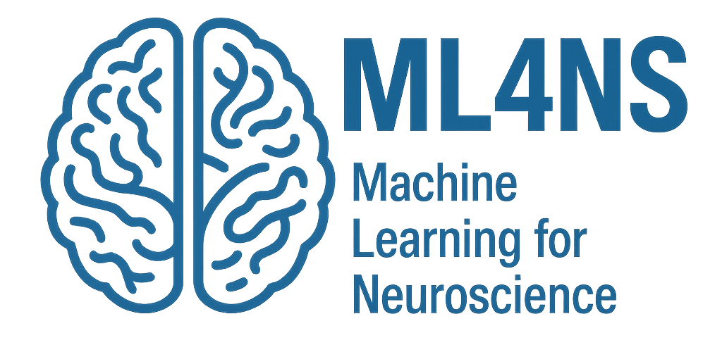
Introduction to Machine Learning
Payam Barnaghi
Department of Brain Sciences &
School of Convergence Science (Human and Artificial Intelligence)
Imperial College London
January 2026
Notes:
1

Slide 2
Leia: Yaté. Yaté. Yotó. (SUBTITLE: “I have come for the bounty on this Wookiee.”)
C-3PO relays this message and Jabba says he’ll offer 25,000 for Chewie.
Leia: Yotó. Yotó. (SUBTITLE: “50,000, no less.”)
C-3PO relays this message and Jabba asks why he should pay so much.
Leia: Eí yóto.
The above isn’t subtitled, but Leia pulls out a bomb and activates it.
C-3PO : Because he’s holding a thermal detonator!
Jabba is impressed by this and offers 35,000.
Leia: Yató cha.
The above isn’t subtitled, but Leia deactivates the bomb and puts it away.
C-3PO : He agrees.
Order is restored.
Adapted from: The Art of Language Invention: From Horse-Lords to Dark Elves, The Words Behind World-Building, by David J. Peterson, Penguin, 2015.

Slide 3
Leia: Yaté. Yaté. Yotó. (SUBTITLE: “I have come for the bounty on this Wookiee.”)
C-3PO relays this message and Jabba says he’ll offer 25,000 for Chewie.
Leia: Yotó. Yotó. (SUBTITLE: “50,000, no less.”)
C-3PO relays this message and Jabba asks why he should pay so much.
Leia: Eí yóto.
The above isn’t subtitled, but Leia pulls out a bomb and activates it.
C-3PO : Because he’s holding a thermal detonator!
Jabba is impressed by this and offers 35,000.
Leia: Yató cha.
The above isn’t subtitled, but Leia deactivates the bomb and puts it away.
C-3PO : He agrees.
Order is restored.
Adapted from: The Art of Language Invention: From Horse-Lords to Dark Elves, The Words Behind World-Building, by David J. Peterson, Penguin, 2015.

Slide 4
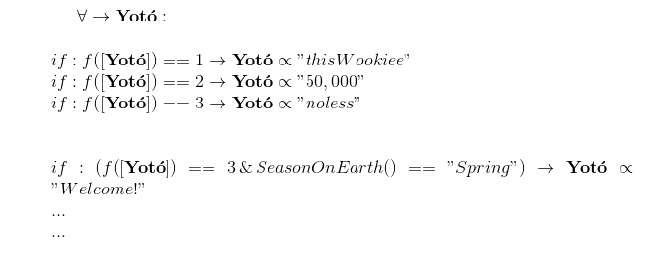

Slide 5
However, don’t underestimate the human brain
For example, in German:
you must distinguish between “the” and “a” articles
and then each one has four case forms
three genders
and singular and plural forms
and then the adjectives have to agree
and then there are verbs!
or take this as an example:
(biáng)
Adapted from: The Art of Language Invention: From Horse-Lords to Dark Elves, The Words Behind World-Building, by David J. Peterson.

Slide 6
Source: https://www.originofalphabet.com/meow-is-just-another-name-for-cat-2/

Slide 7

Source: https://cdn.sinauer.com/wolfe4e/wa07.05.html#Movie1

Slide 8
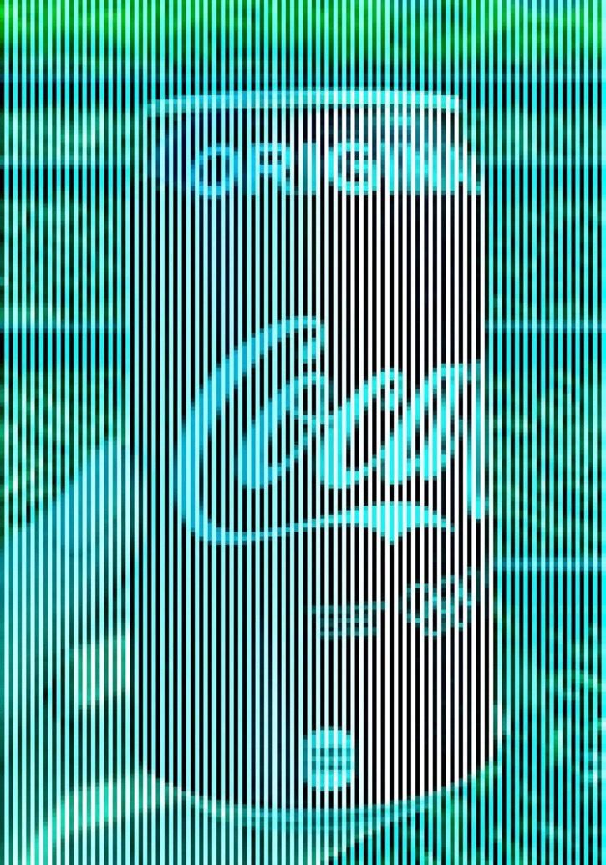


Patterns and generalisation

Slide 9
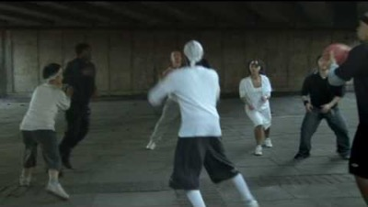
Attention
Source: https://www.youtube.com/watch?v=xNSgmm9FX2s
Via: https://www.youtube.com/watch?v=48gBPL7aHJY&t=0s

Slide 10
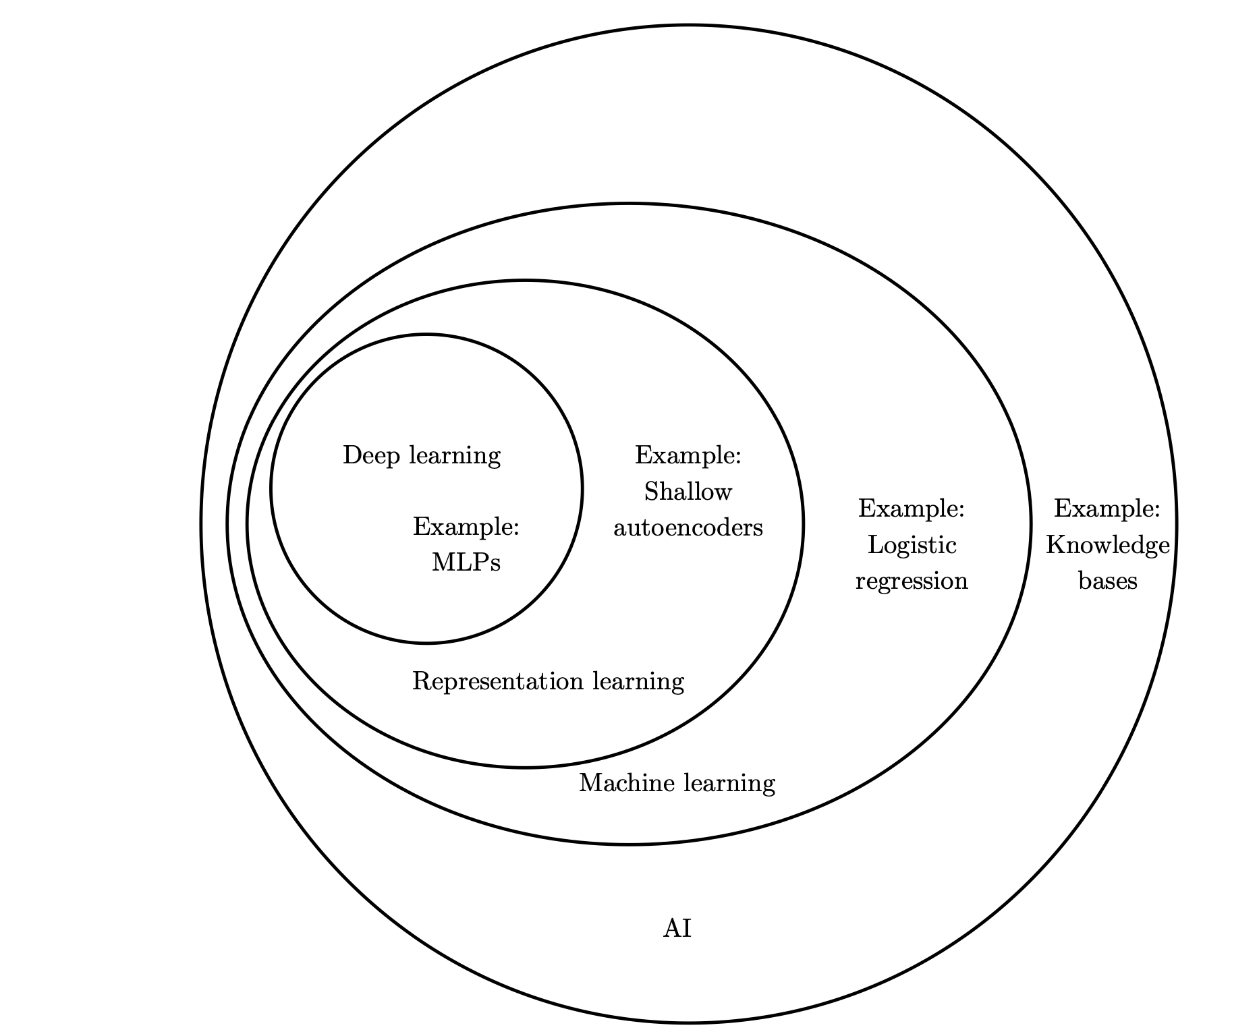
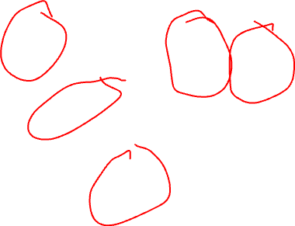
AI and Machine Learning
Source: Deep Learning, Ian Goodfellow et al., MIT Press.

Slide 11
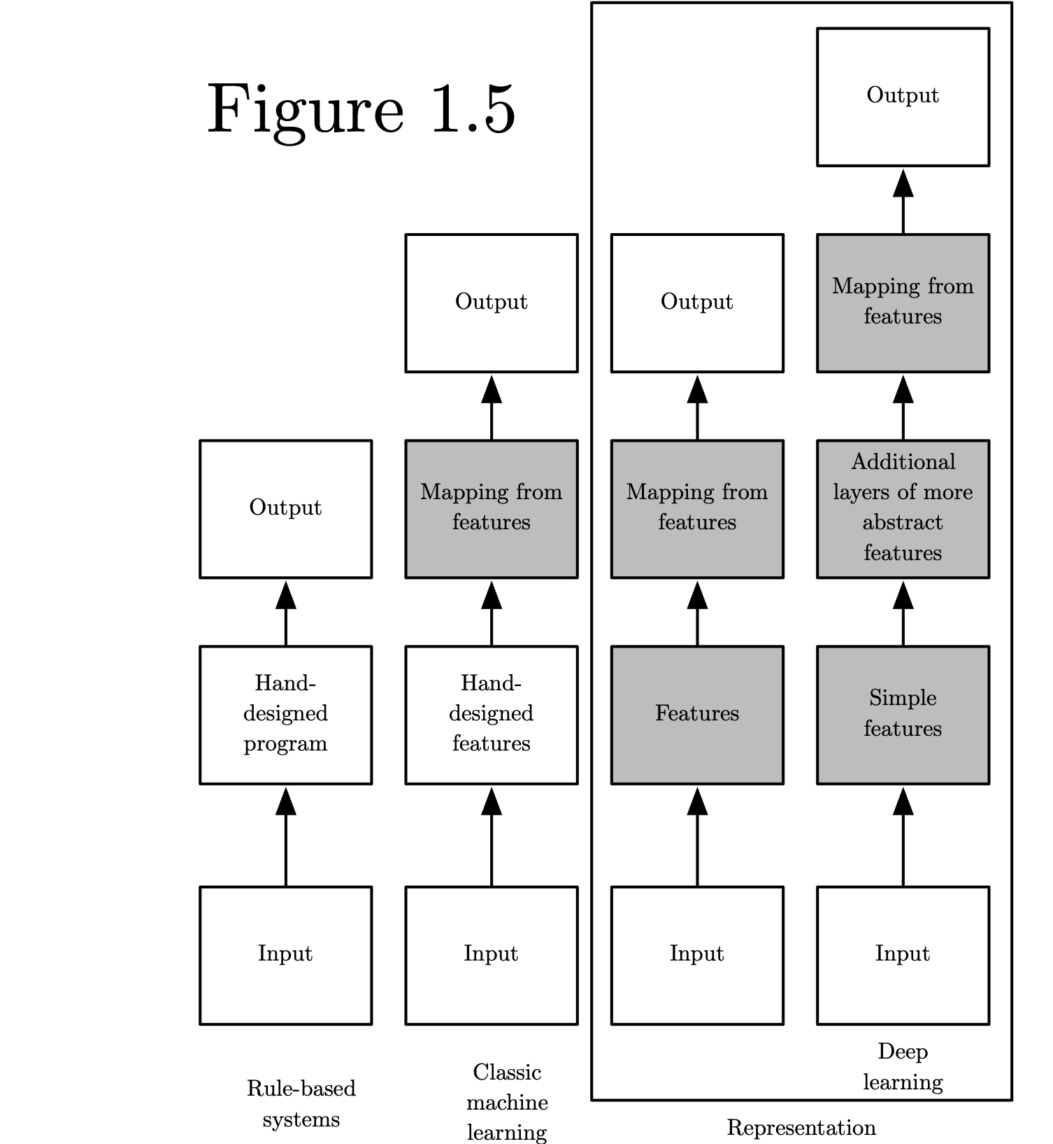
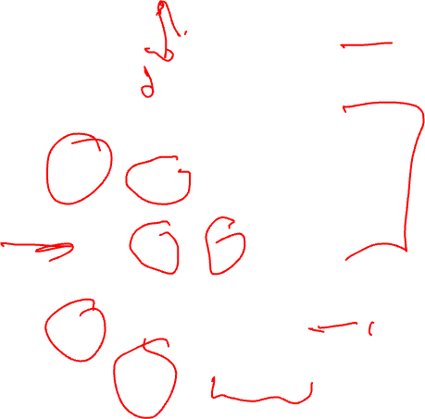
Categories of learning and intelligent systems
Source: Deep Learning, Ian Goodfellow et al., MIT Press.

Slide 12
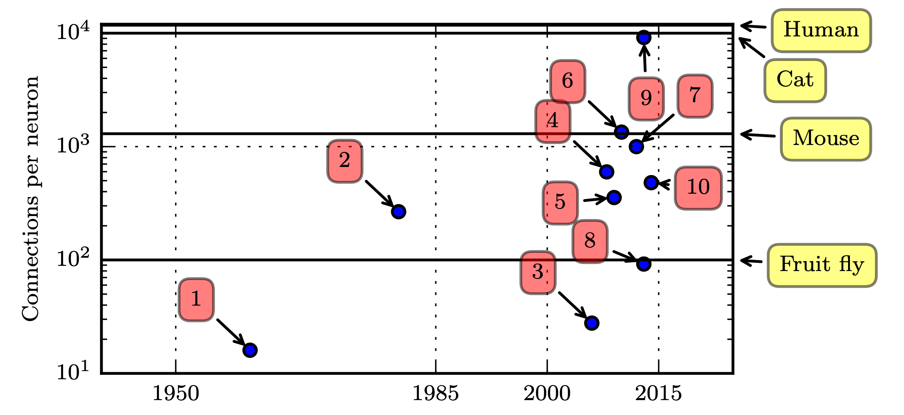
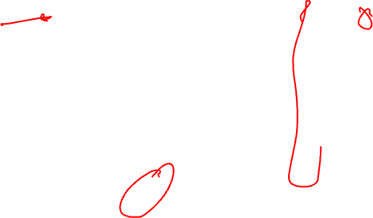
Connections per neuron
Adaptive linear element (Widrow and Hoff, 1960)
…
8. Multi-GPU convolutional network (Krizhevsky et al., 2012)
9. COTS HPC unsupervised convolutional network (Coates et al., 2013)
Source: Deep Learning, Ian Goodfellow et al., MIT Press.

Slide 13
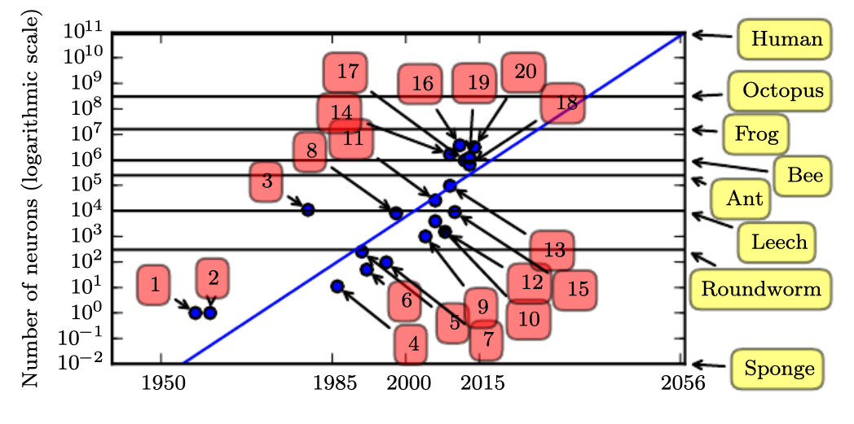

Number of neurons
17. Distributed autoencoder (Le et al., 2012)
18. Multi-GPU convolutional network (Krizhevsky et al., 2012)
19. COTS HPC unsupervised convolutional network (Coates et al., 2013)
20. GoogLeNet (Szegedy et al., 2014a)
- The human brain has approximately 86 billion neurons
- The GPT-4 model has approximately 1.8 trillion parameters.
- However, the artificial neurons are not equal to biological neurons
Source: Deep Learning, Ian Goodfellow et al., MIT Press.

Slide 14
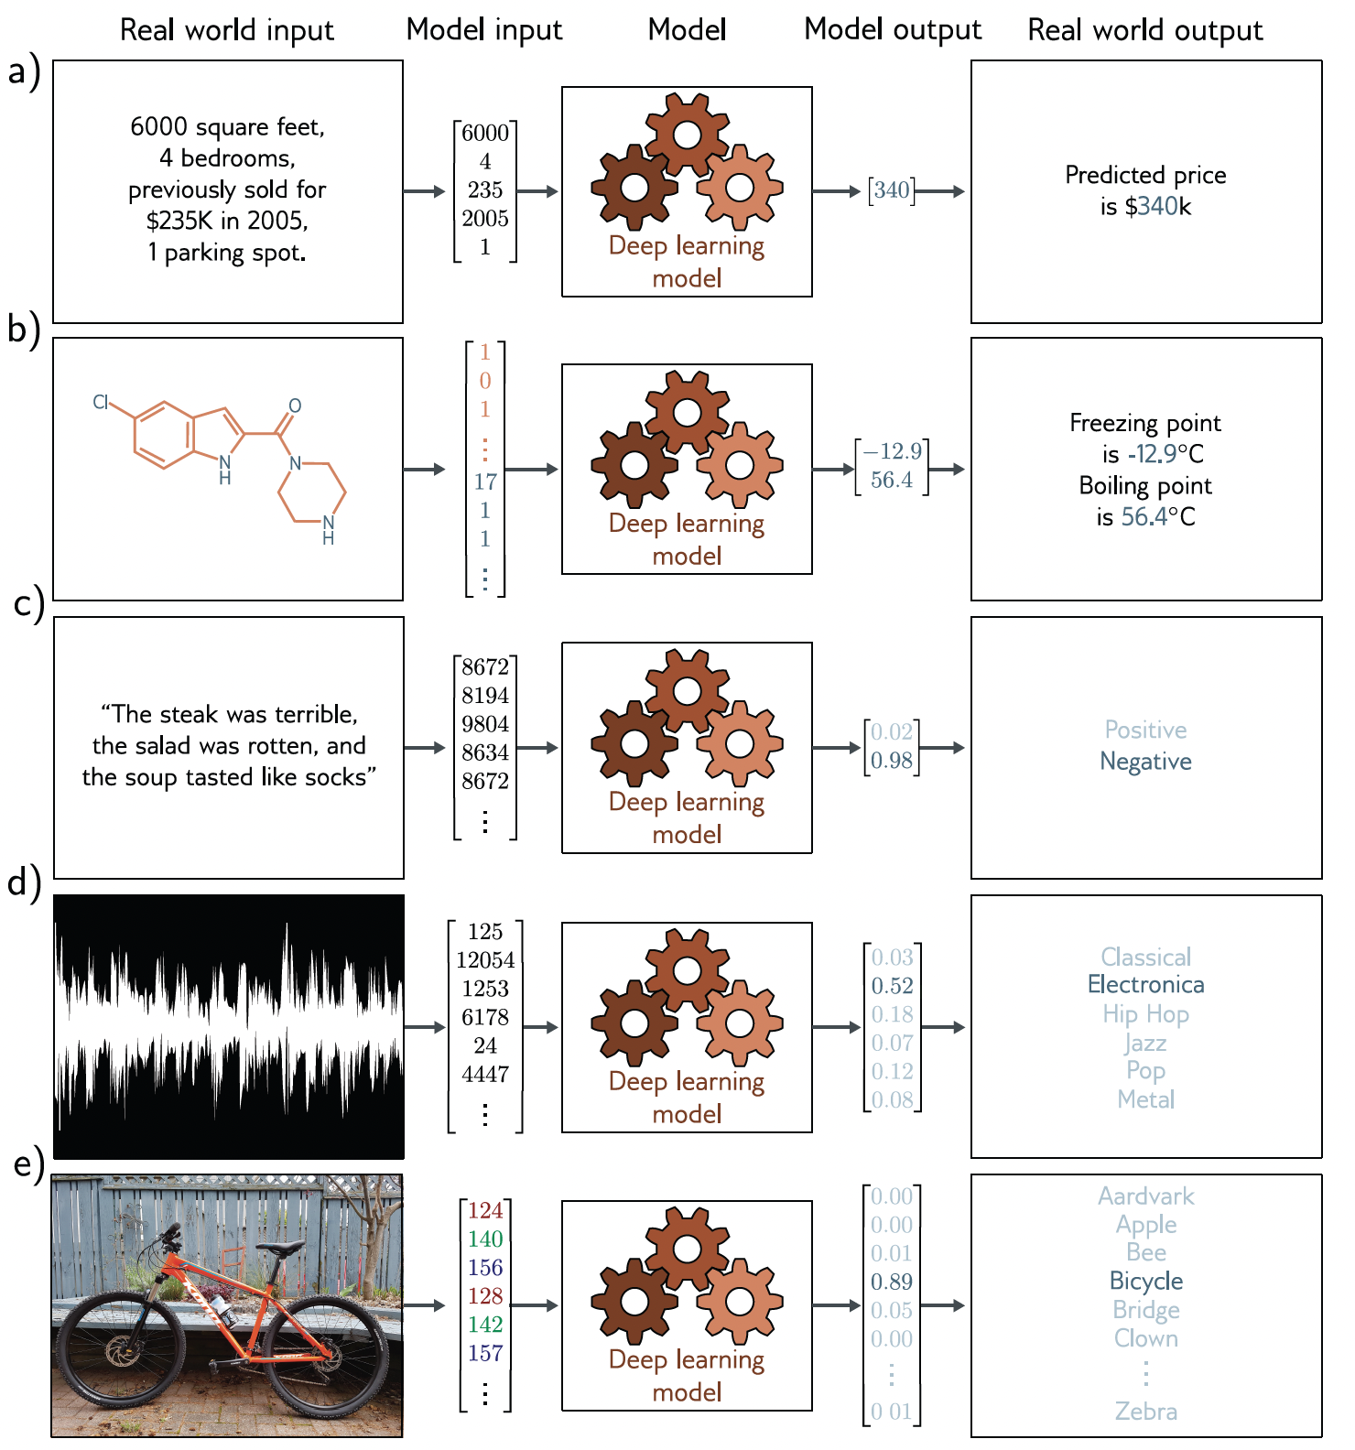
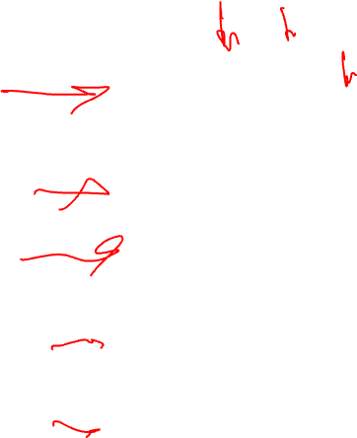
Machine learning models
Source: Understanding Deep Learning, Simon J.D. Prince, MIT Press.

Slide 15
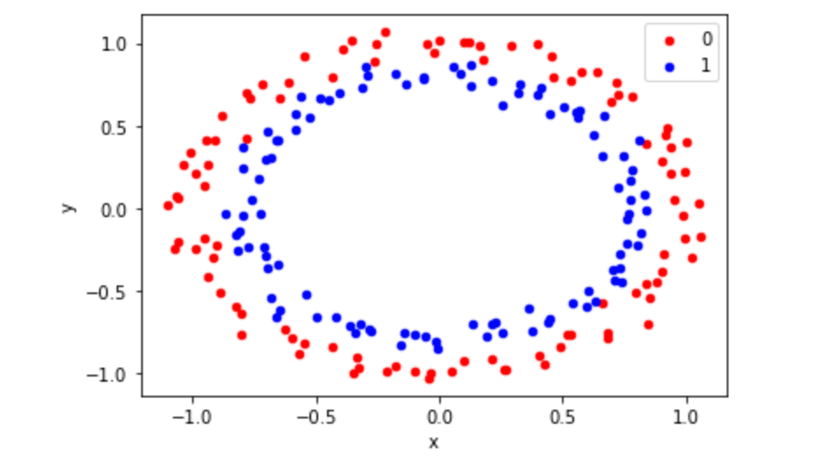
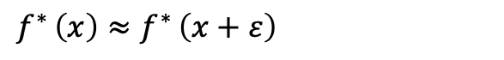
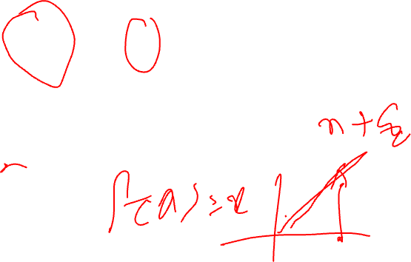
Machine Learning (ML)
Most of machine learning methods are designed as a learning process to learn a function f* for which:
- In other words, this means if we know the answer for a training sample x, then that answer is probably good in the neighbourhood of x.
$f^{∗ }\left(x\right)≈$ $f^{∗ }\left(x+ε\right)$

Slide 16
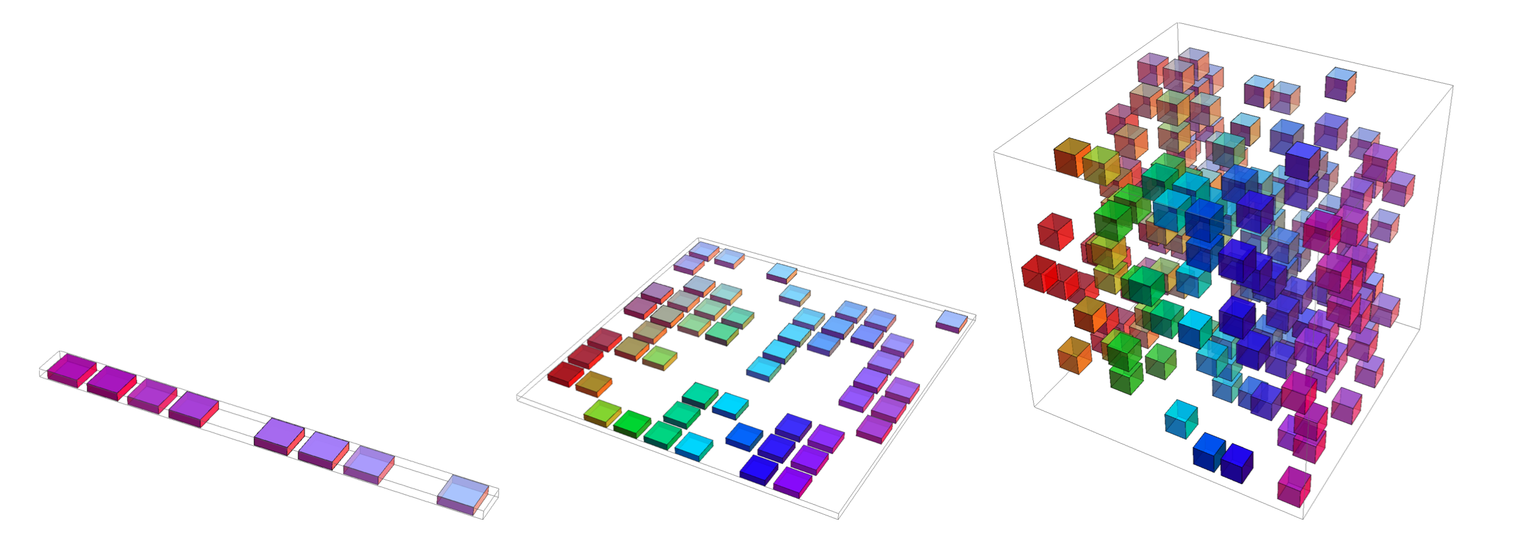
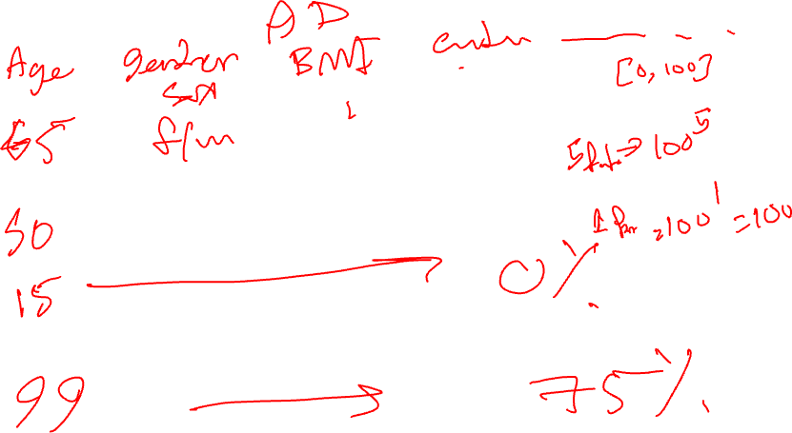
Curse of dimensionality
Overall, for d dimensions with v values we need O(v^{d}) regions and examples
Source: Deep Learning, Ian Goodfellow et al., MIT Press.

Slide 17
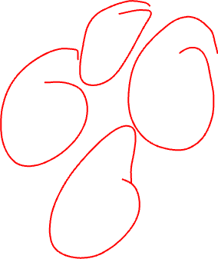
K-nearest neighborhood

Slide 18
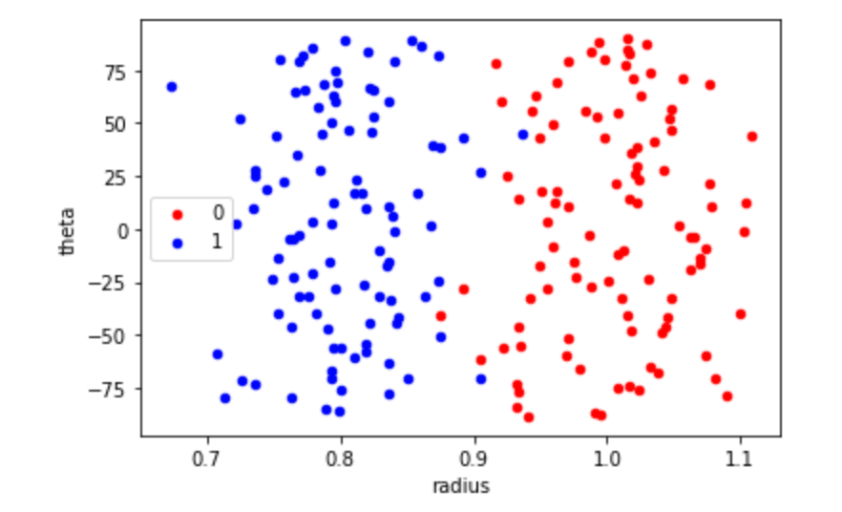
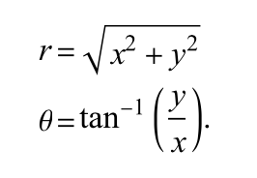
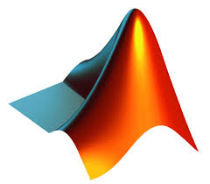

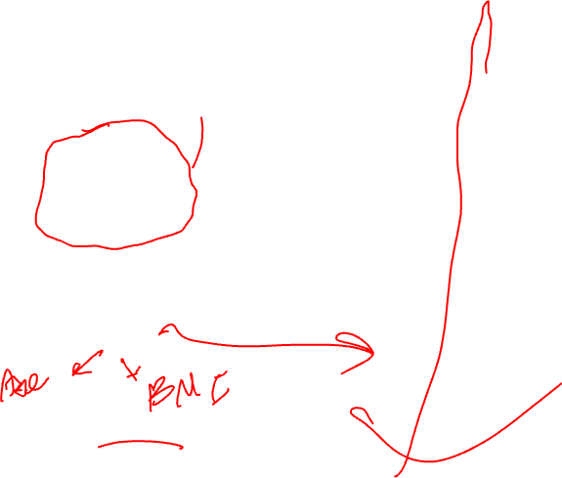
Data/sample representation
(x,y)
<Code>
https://github.com/PBarnaghi/Basic-ML-Code

Slide 19
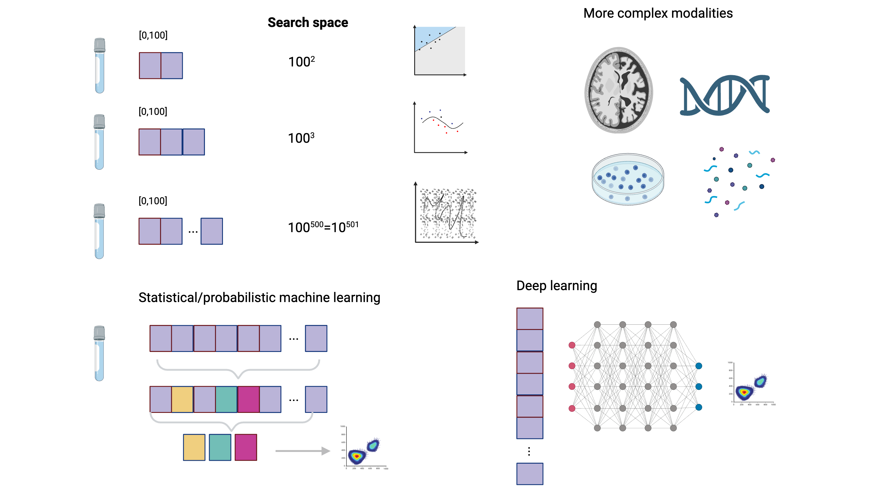
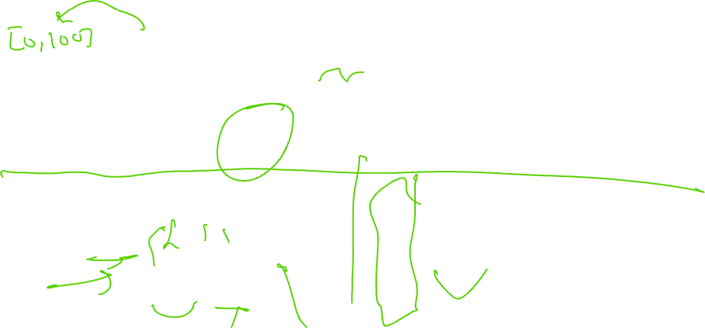
Machine Learning: looking back, moving forward

Slide 20
What you are going to learn in this module
Core Concepts
Principles of machine learning models
Designing ML models for neuroscience and medical applications
Hands-On Skills
Select suitable models for specific tasks
Design machine learning experiments
Apply appropriate metrics to evaluate models
Detect and address common issues (e.g., overfitting, underfitting)
Evaluate potential bias and fairness in models and their outcomes

Slide 21
By the end of this module
You should be able to:
Construct machine learning experiments
Create and run different probabilistic/statistical learning and deep learning models
Read and interpret existing works and assess their applicability/validity [to different use cases]
Be familiar with common concepts such as training/test, cross-validation, and performance evaluation metrics
Learn about common issues and pitfalls in developing ML models
Obtain practical experience in developing ML models and running (simple) experiments.

Slide 22
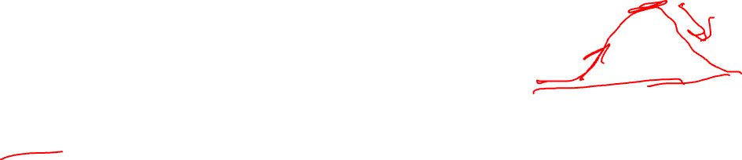
Key topics covered
Introduction to machine learning
Regression models and linear prediction
Probability and information theory
Bayesian models and maximum likelihood estimation
Linear models, ensemble models and kernel functions
Artificial Neural Networks (ANNs) and Multilayer Perceptron (MLP) models
Deep Neural Networks (DNN) and Deep Learning (DL)
Convolutional Neural Networks (CNNs)
Responsible machine learning and ethical considerations
Applications in neuroscience and neuroscience-inspired machine learning
Ethical AI/ML: principles and practices

Slide 23
Module delivery
10 teaching sessions
Primary tutorials and workshops (primary programming and data handling/visualisation skills)
2 hours lectures (Mon-Fri; 10:30-12:30) for two weeks in January 2026.
3 hours lab experiments (supported by TAs)
One final project (modelling and machine learning experiment using a real-world dataset)

Slide 24
Datasets
Syntenic data to demonstrate the concepts
In-home monitoring data in a dementia cohort study from the UK DRI Minder/TIHM Study (movement, sleep, physiology, and associated healthcare events), in the form of numerical time-series data (Final Project)
Common benchmark imaging data (non-medical) such as CIFAR-10
MRI data to build a CNN model
Publicly available clinical/experimental datasets
e.g. Physionet.org

Slide 25
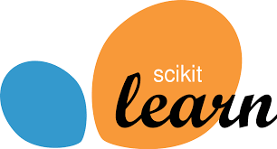


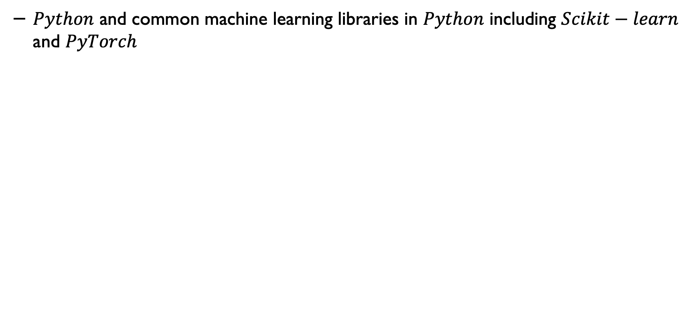
Tools and languages
$Python$ and common machine learning libraries in $Python$ including $Scikit−learn$ and $PyTorch$

Slide 26

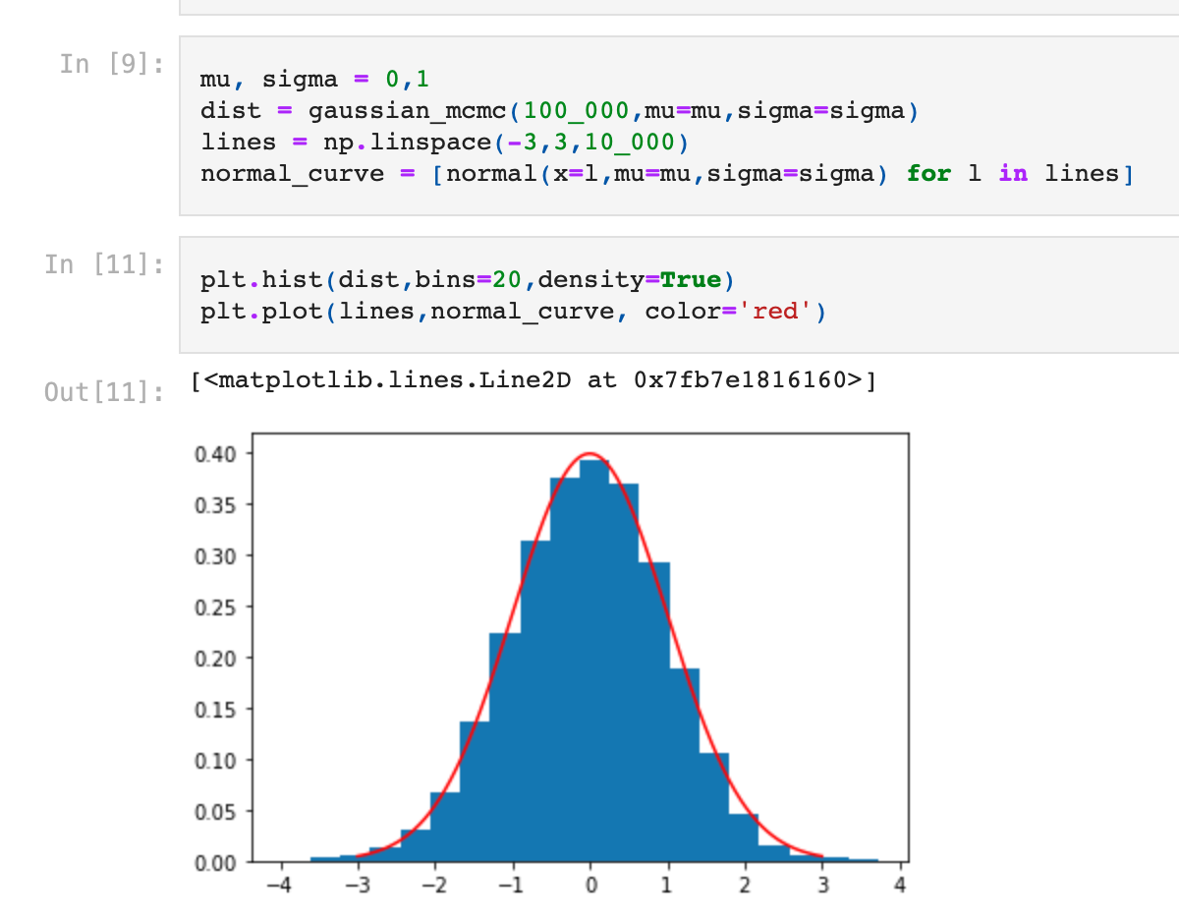
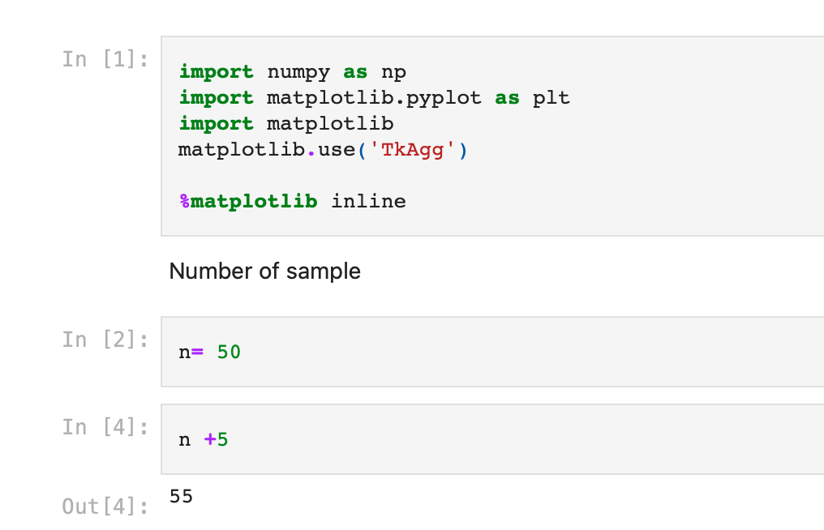
Development/learning framework

Slide 27
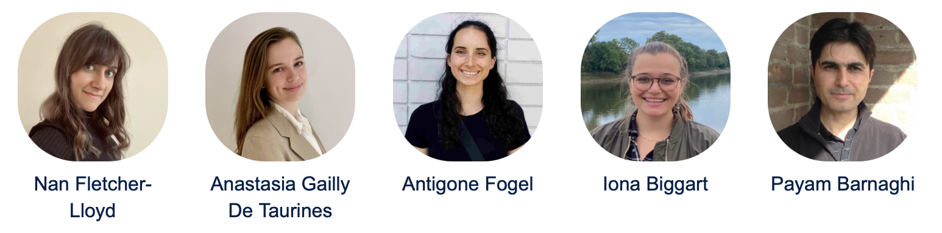
Teaching team

Slide 28
Our Aim
We aim to encourage neuroscientists and clinical scientists to enjoy developing robust and reliable AI/ML models for practical applications. We hope this will help to prosper the practice of medicine and discovery science.
We hope this module will remove some of the fears naturally felt when starting a career in computational neuroscience and computational modelling in medicine and bioscience, thereby allowing the practitioners to focus on solving unmet health and care needs and advancing knowledge and practice of neuroscience and medicine.
The text is inspired by the preface of the Oxford Handbook of Clinical Medicine by I. Wilkinson et al.

Slide 29
”Patients” and “Patient data”
The terms "patient" and "patient data" will appear throughout this module in the slides and presentations. Please note that we do not take this lightly. Every single piece of data displayed or used from anonymised patient information throughout this module is donated to science by individuals.
We are grateful for their contributions, which support scientific discovery to enhance existing procedures and to design and develop new treatments and practices.
Privacy and the ethical use of data and modelling are essential elements of any AI/ML design.
Inspired by the Oxford Handbook of Clinical Medicine by I. Wilkinson et al. and a talk given by Junaid Bajwa, Flagship Pioneering.

Slide 30
Frequently Asked Questions (I)
I don’t know Python. Can I take this module?
Yes, we have provided an introductory lecture/workshop on Python (at the level required for this module).
I haven’t done any programming before. Can I still take this module?
Yes, but you should be prepared to learn scripting/programming and get familiar with the concepts quickly. We will provide examples/templates to follow, and there is plenty of online material, but there will be a steep learning curve.

Slide 31
Frequently Asked Questions (II)
Machine learning seems to involve a lot of mathematics, especially statistics and probability. Do I need to know all these before taking this module?
You need to be familiar with the basic concepts of statistics and probability, but we have provided a brief refresher online tutorial.
The lecture content/concepts will not be mathematically focused, but when needed, the underlying mathematical concepts will be described/shown to elaborate on the concepts.
Learning mathematical concepts in a group is often easier.
We will focus on concepts and skills that won’t be easy to find or learn from a series of online videos.

Slide 32
Concepts that will not be covered in this module
Image processing and machine learning for medical imaging
Natural language processing and text analysis
Advanced machine learning and deep learning concepts such as transfer learning, generative models (some of these will be covered in an optional series after the module)
Signal processing and feature engineering for specific modalities/data such as EEG, ECG, and Brain imaging

Slide 33
What will I learn in this module?
Primary concepts and foundations of machine learning (statistical/probabilistic learning and deep learning models).
Some of the basic/key models to design and develop supervised and unsupervised machine learning.
Cross-validation, hyperparameter tuning, and evaluation metrics
Hands-on skills and working with real-world data, and designing/evaluating models with different real-world datasets.
Ultimately, this module (hopefully) will help you learn fundamental concepts on how ML models are constructed and applied to real-world problems.

Slide 34
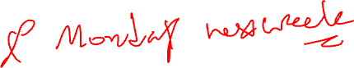
Module assessment
2 Marked Lab assignments (50%)
Lab 5 (Friday)
This assessment will consist of pen-and-paper multiple-choice questions. You may prepare and bring one A4 double-sided cheat sheet.
Lab 8 (Wednesday)
This assessment will consist of a series of questions on a use case to be reviewed/evaluated.
Final project (50%)
In the 2nd week, we will give you a dataset and ask you to:
Conduct a set of exploratory data analyses
Develop a simple ML model and evaluate it
Code with markdown in Jupyter Notebook will be sufficient.
- Assessments will be on Blackboard.

Slide 35
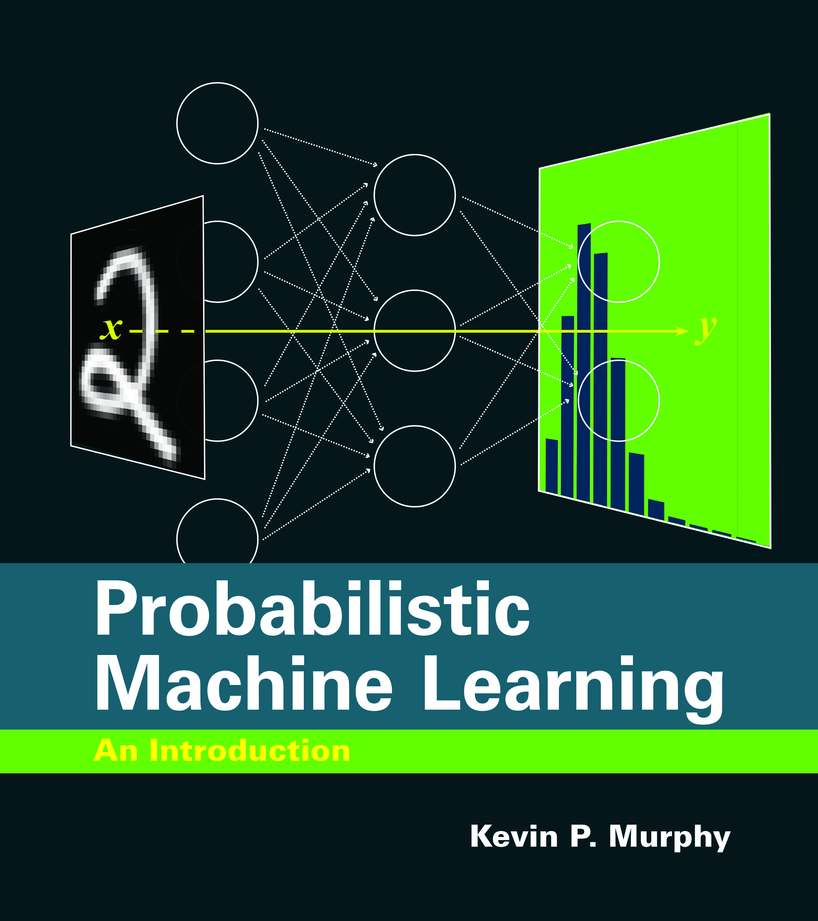
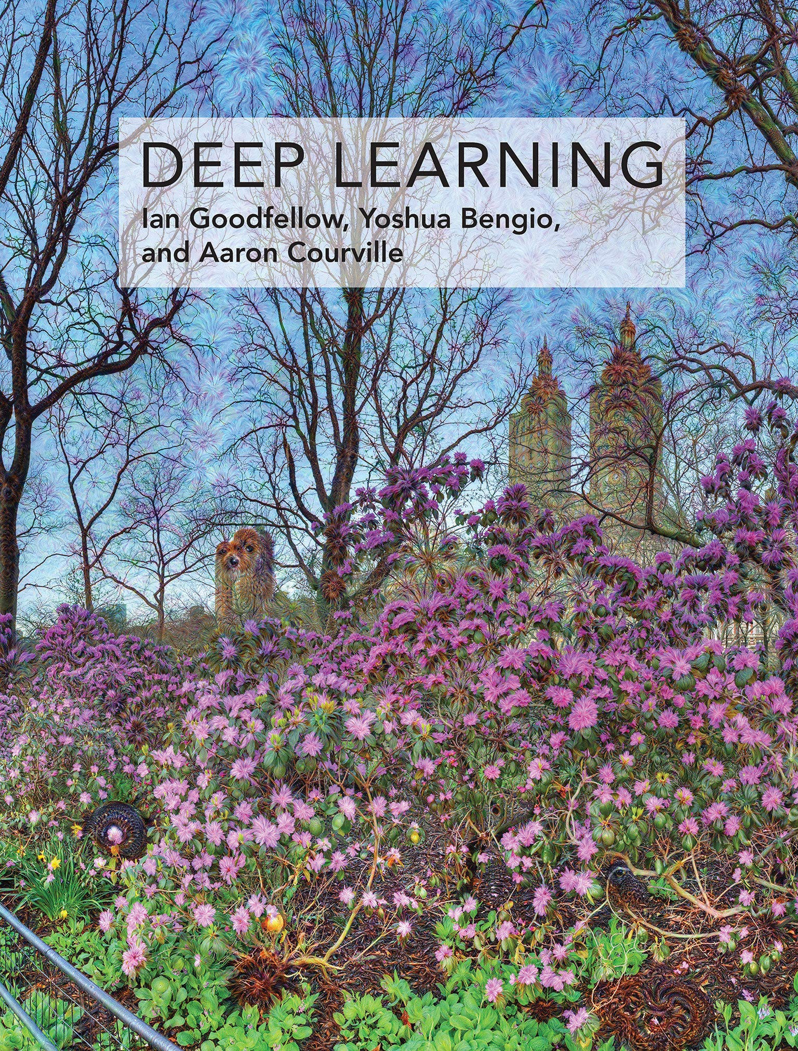
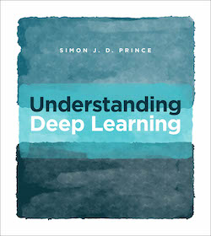
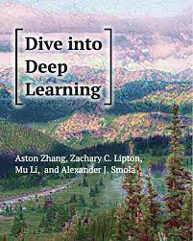
Reference and sources
Probabilistic Machine Learning Kevin P. Murphy, MIT Press
Deep Learning
Goodfellow et al., MIT Press
Understanding Deep Learning, Simon J.D. Prince, MIT Press
Dive into Deep Learning
Aston Zhang et al.
Links to Preprints (PDFs/online versions):
- Probabilistic Machine Learning: An Introduction, https://probml.github.io/pml-book/book1.html
- Deep learning: https://www.deeplearningbook.org
- Understanding Deep Learning, https://udlbook.github.io/udlbook/
- Dive into deep learning, https://d2l.ai/index.html

Slide 36
Some other online sources
Andrew Ng lecture notes: https://cs229.stanford.edu/lectures-spring2022/main_notes.pdf
https://towardsdatascience.com/machine-learning/
Good online sources for questions/troubleshooting
https://stackoverflow.com
https://stackexchange.com

Slide 37
MS Teams Link

Slide 38

Typical machine learning approaches
Supervised learning
Unsupervised learning
Reinforcement learning

Slide 39
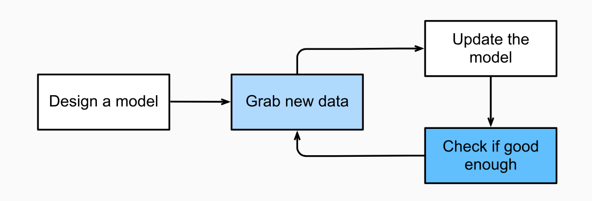

Machine learning development
Is this the right approach?
Source: Dive into Deep Learning, Aston Zhang et al.

Slide 40
Key components of ML development
The data that we can learn from.
A model of how to transform the data.
An objective function that quantifies how well (or badly) the model is doing.
An algorithm to adjust the model’s parameters to optimise the objective function.
Source: Dive into Deep Learning, Aston Zhang et al.

Slide 41
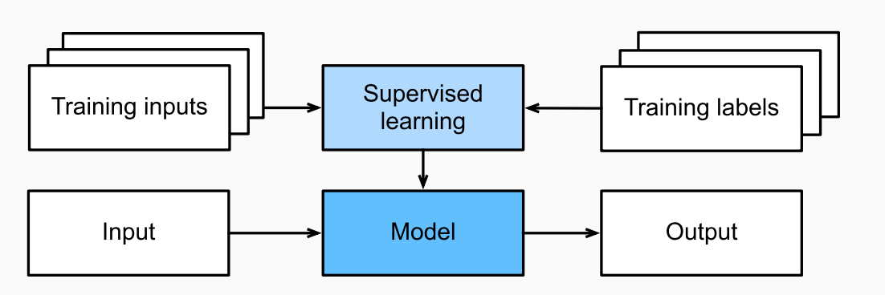

Supervised learning
In supervised learning the data comes with additional attributes (i.e. labels) that we want to predict.
Source: Dive into Deep Learning, Aston Zhang et al.

Slide 42
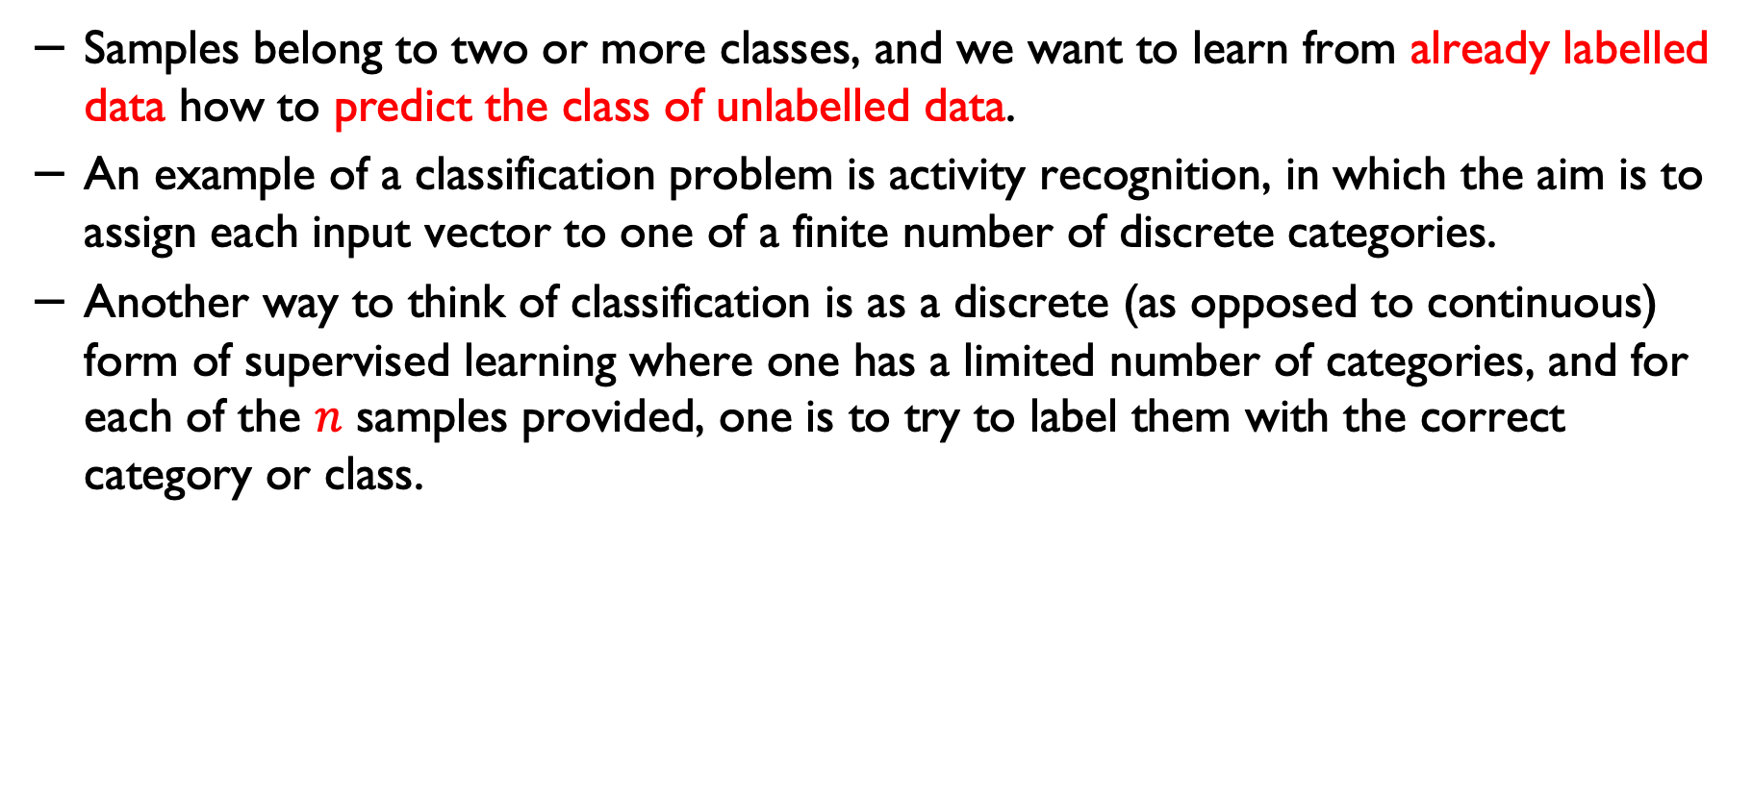
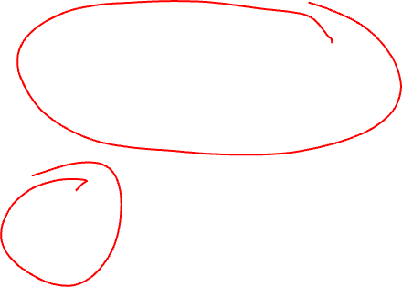
Classification
Samples belong to two or more classes, and we want to learn from already labelled data how to predict the class of unlabelled data.
An example of a classification problem is activity recognition, in which the aim is to assign each input vector to one of a finite number of discrete categories.
Another way to think of classification is as a discrete (as opposed to continuous) form of supervised learning where one has a limited number of categories, and for each of the $n$ samples provided, one is to try to label them with the correct category or class.
Source: Scikit learn documentation

Slide 43
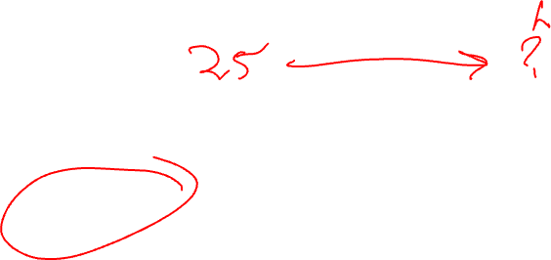
Regression
The task is called regression if the desired output consists of one or more continuous variables.
An example of regression problems:
How long will it take for an Alzheimer's Disease AD patient to decline to an MMSE* score of x? (judging by previously seen data)
How long will it take for a patient to decline from one stage to another stage (in a neurodegenerative condition)?
Predicting the length of hospital stay for a patient
* MMSE: The Mini-Mental State Examination (MMSE)

Slide 44
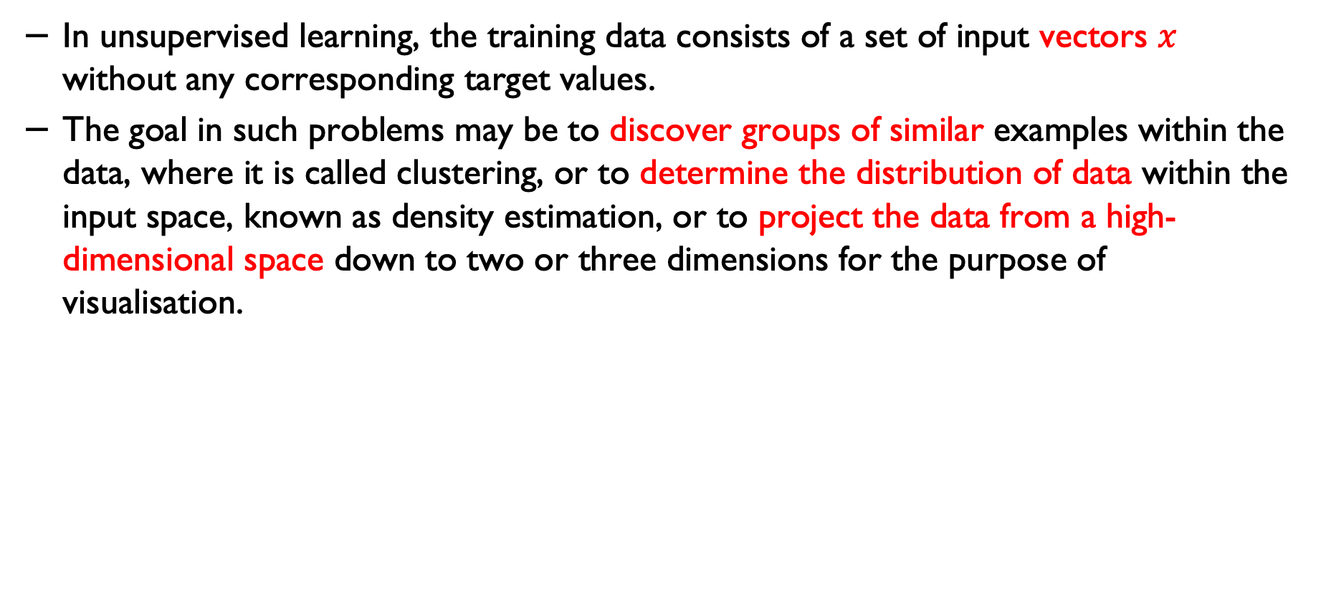
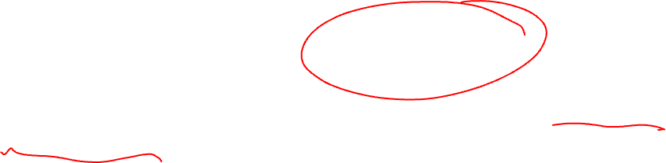
Unsupervised learning
In unsupervised learning, the training data consists of a set of input vectors $x$ without any corresponding target values.
The goal in such problems may be to discover groups of similar examples within the data, where it is called clustering, or to determine the distribution of data within the input space, known as density estimation, or to project the data from a high-dimensional space down to two or three dimensions for the purpose of visualisation.
Source: Dive into Deep Learning, Aston Zhang et al.

Slide 45
Training set and testing set
Machine learning is about learning some properties of a data set and applying them to new data.
This is why a common practice in machine learning to evaluate an algorithm is to split the data at hand into two sets, one that we call the training set, on which we learn data properties and one that we call the testing set, on which we test these properties.
Source: Dive into Deep Learning, Aston Zhang et al.

Slide 46
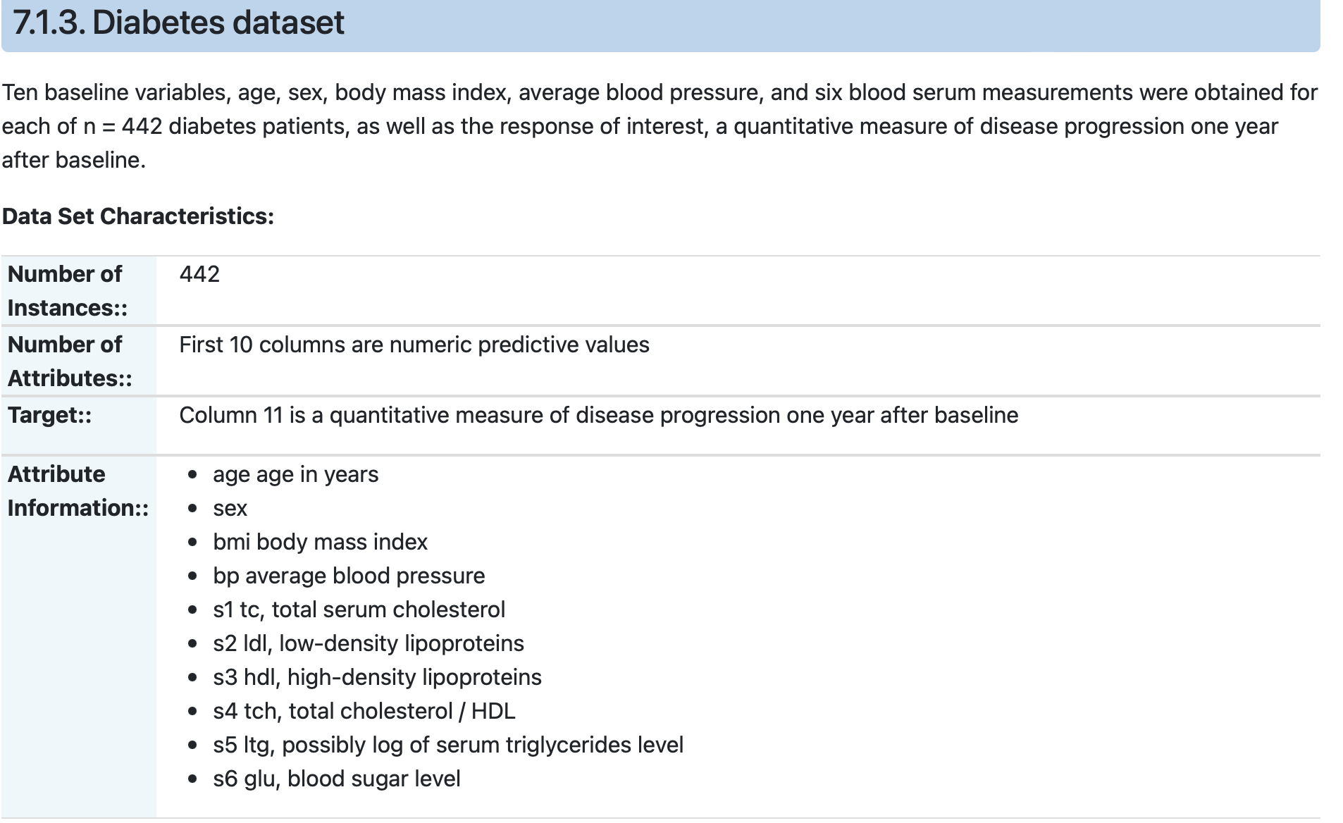
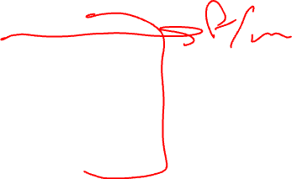
Dataset
https://www4.stat.ncsu.edu/~boos/var.select/diabetes.html

Slide 47
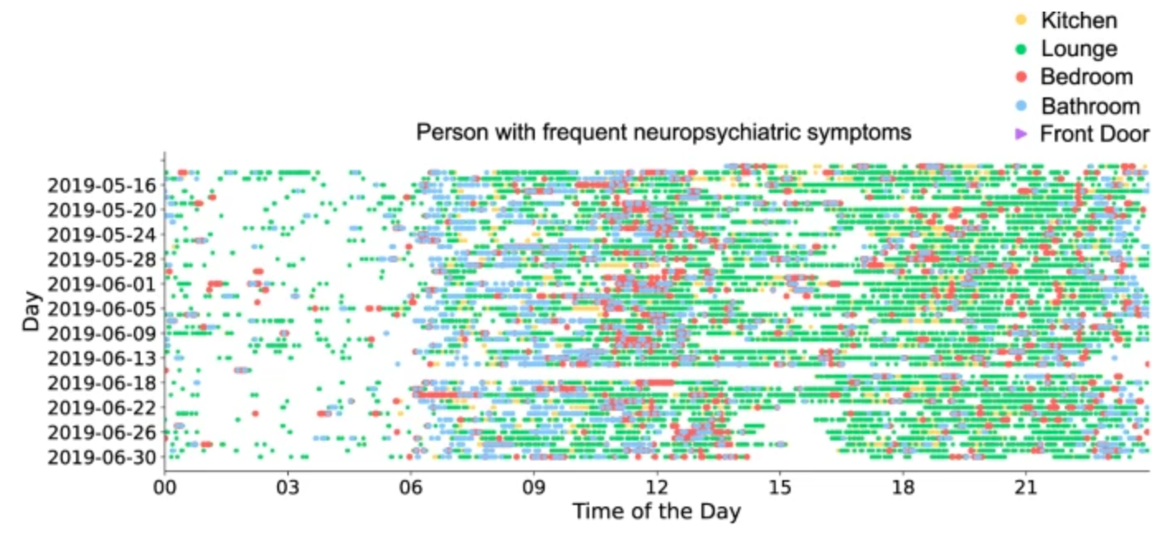
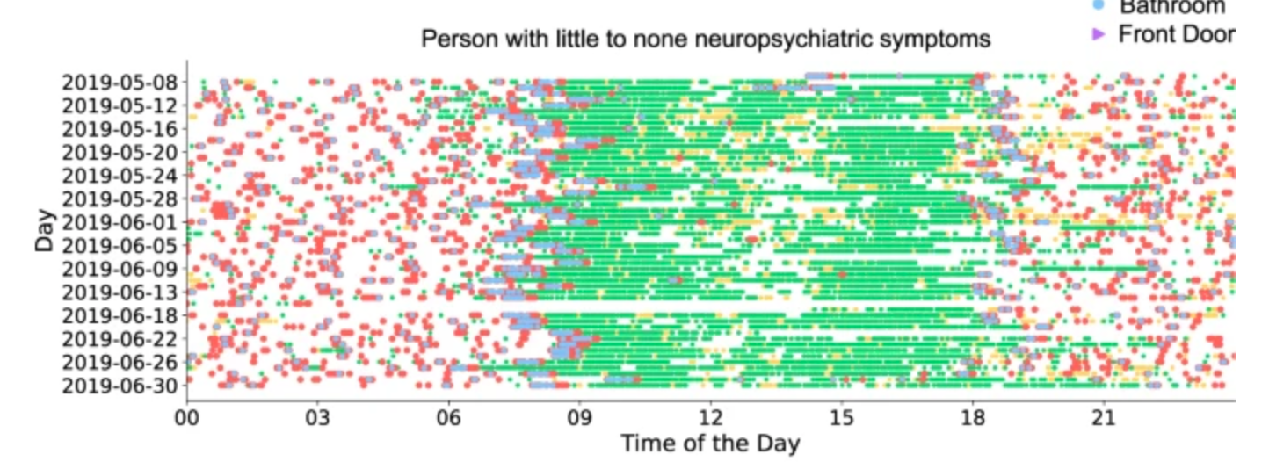
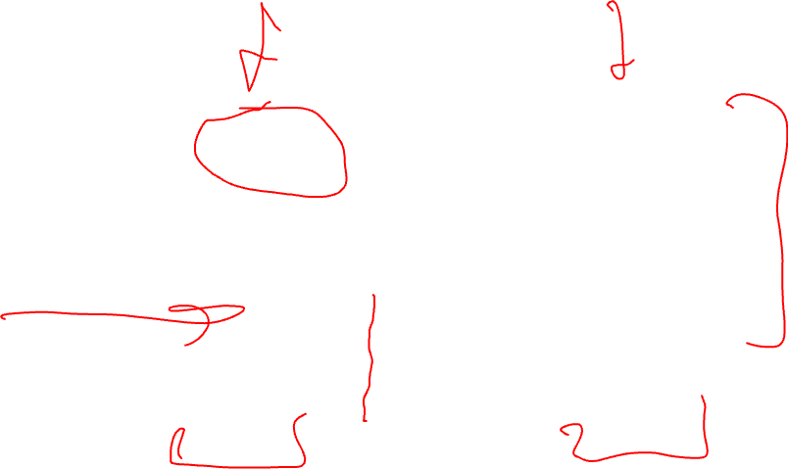
Datasets
Palermo, F., Chen, Y., Capstick, A. et al. TIHM: An open dataset for remote healthcare monitoring in dementia. Sci Data, 10, 606 (2023).

Slide 48
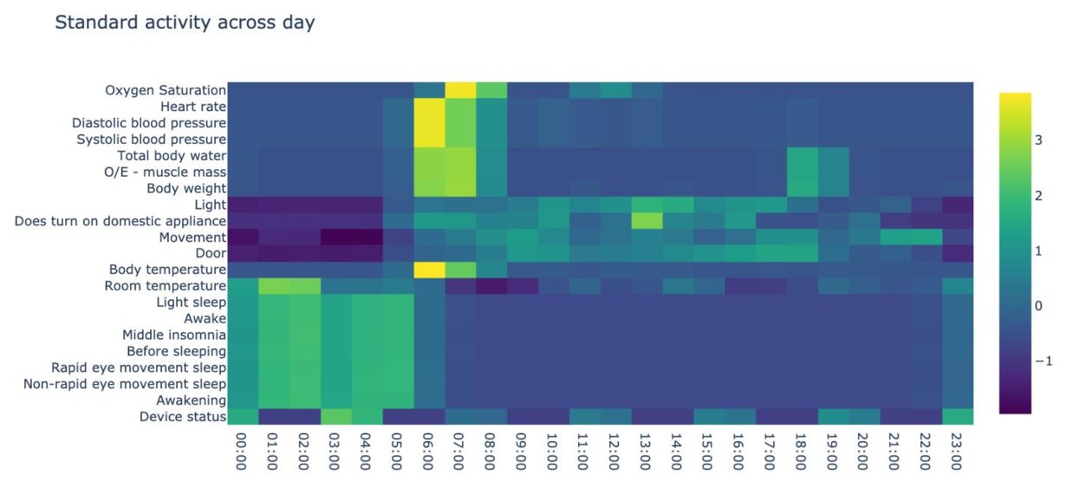
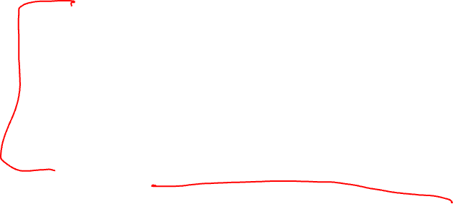
A sample data for in-home activity

Slide 49

Dataset in the code/programming environment

Slide 50


Multivariate data
In general, a learning problem involves a set of n data samples and aims to predict the properties of previously unseen data.
If each sample is more than a single number and, for instance, a $multi−dimensional$entry (aka multivariate data), it is said that the data has several attributes or features.

Slide 51

Feature vector

Slide 52

Training, Test and Validation
Training: is used to train the models and determine their parameters (e.g. weights in a neural network).
Validating: Once you have a collection of algorithms, you need to pick one model. Sometimes, the model that performs best on the validation set is picked up.
Testing: We use a test set after a model is chosen, but we don't yet know its performance on unseen data. We can apply the chosen model to a test set to see its performance on unseen data.
How to divide the data? e.g. 60%, 20%, 20%; or 70%, 20%, 10% (need to make sure/check about potential bias and balance/imbalance- more on this later during this module).

Slide 53


Unsupervised learning
J. Li et al., under review, 2023.
Length of stay (log scale)
Rate of emergency surgeries
Image source: J. Li et al., BMC Medical Informatics and Decision Making, 2024.

Slide 54
Clustering
The problem that needs to be solved in clustering:
For example, given a dataset, if we knew there were 3 groups but did not have access to a taxonomy (i.e., labels) to directly identify them, we could try a clustering task.
This means splitting the data into well-separated groups called clusters.

Slide 55


K-means clustering
The $K−means algorithm clusters data by trying to separate samples into$ a set of equal variance, minimising a criterion known as the inertia or within-cluster sum-of-squares.
This algorithm requires the number of clusters to be specified.
It scales well to a large number of samples and has been used across a wide range of application areas.
The algorithm divides a set of N samples into K disjoint clusters C_{i}, each described by a mean μ_{i}.
Source: Scikit learn documentation

Slide 56


K-means

Slide 57




K-Means
The means are commonly called the cluster “centroids”; note that they are not, in general, points from $X$, although they live in the same space.
The K-means algorithm aims to choose centroids that minimise the inertia, or within-cluster sum of squared criterion:
$$\sum_{i=0}^{n}{\min{({\left\|μ_{j} −μ_{i}\right\|}^{2})}}$$
$μ_{j}∈C$

Slide 58


How K-means works
K-means has three steps.
The first step chooses the initial centroids, with the most basic method being to choose k samples from the dataset $X$.
After $initialisation$, K-means consists of looping between the two other steps.
The first step assigns each sample to its nearest centroid. The second step creates new centroids by taking the mean value of all the samples assigned to each previous centroid.
The difference between the old and the new centroids are computed, and the algorithm repeats these last two steps until this value is less than a threshold. In other words, it repeats until the centroids do not move significantly.

Slide 59
K-Means Algorithm
First, the initial cluster for each of the points is calculated using the current centroids.
Secondly, the centroids are updated to the mean of each segment.
The algorithm then repeats this until a stopping criterion is fulfilled (e.g. error rate below a certain threshold).
Or, for example, iteration stops when centroids move less than a threshold.

Slide 60
Convergence in K-means
Performing enough iterations, K-means will converge; however, it may converge to a local minimum. This is highly dependent on the initialisation of the centroids.
As a result, the computation is often done several times, with different initialisations of the centroids.
Generally, repats are very important in developing robust machine learning models (more on this in the coming days).

Slide 61
Convergence in K-means
One method to address this issue is the “k-means++” initialisation scheme, which is implemented in scikit-learn (use the init='kmeans++' parameter).
This initialises the centroids to be (generally) distant from each other, leading to provably better results than random initialisation, as shown in the reference.
Source: Scikit learn documentation

Slide 62

K-means Example
Before you need to install sci-kit learn
In Mac OS
$sudo easy_install pip$
$pip install −U numpy scipy scikit−learn$
In Linux
$sudo apt−get install build−essential python−dev python−setuptools \backslash python−numpy python−scipy \backslash libatlas−dev libatlas3gf−base$

Slide 63
Open discussion
Discussion Scenario:
You’ve built a machine learning model that predicts Alzheimer’s risk over the next 5 years based on age, sex, comorbidities, and current MMSE score.
For one individual, the model outputs a risk score of 75 (out of 100).
Question:
Your clinician colleague asks: “How should I interpret this result?” What would your response be?
For more information: Biggart I., Fogel A., Barnaghi, P., Predicting Dementia Risk Using Longitudinal Electronic Health Records Data, 39th Conference on Neural Information Processing Systems (NeurIPS 2025) Workshop: Learning from Time Series for Health, https://openreview.net/pdf?id=2FfRHgVSx3

Slide 64
Practice questions

Slide 65
Practice questions
In a machine learning experiment, we have 1000 samples. We divide the data into training, validation and test sets as below:
Training samples: 300
Validation samples: 200
Test samples: 500
Is this a good split?
Please go to menti.com and add your response (code will be given)

Slide 66
Hospital stay
In a machine learning experiment, you have been asked to design a model that can predict hospital stays for people who are admitted to a neurology ward.
What type of model will you use to design your model?

Slide 67
If you have any questions
Please feel free to arrange a meeting or email (p.barnaghi@imperial.ac.uk).
To arrange a meeting, please email my colleague, Ms Rhiannon Kirby.
My office: 928, Sir Michael Uren Research Hub, White City Campus.

